Slide 1
Implementing
multi layer perceptron
with MNIST
Sungjoon Choi
(sungjoon.choi@cpslab.snu.ac.kr)

Slide 11
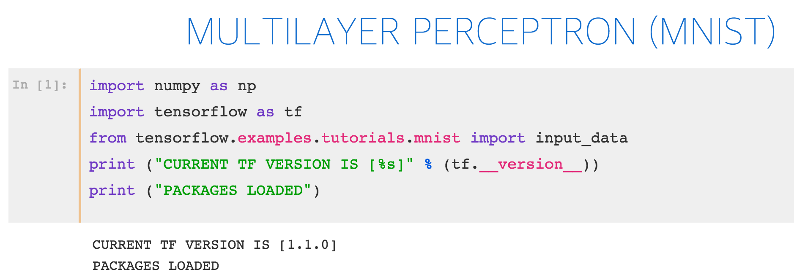
Notes:
import numpy as np
import tensor flow as tf
import matplotlib.pyplot as plt
from tensorflow.examples.tutorials.mnist
import input_data
%matplotlib inline print ("PACKAGES LOADED")

Slide 12
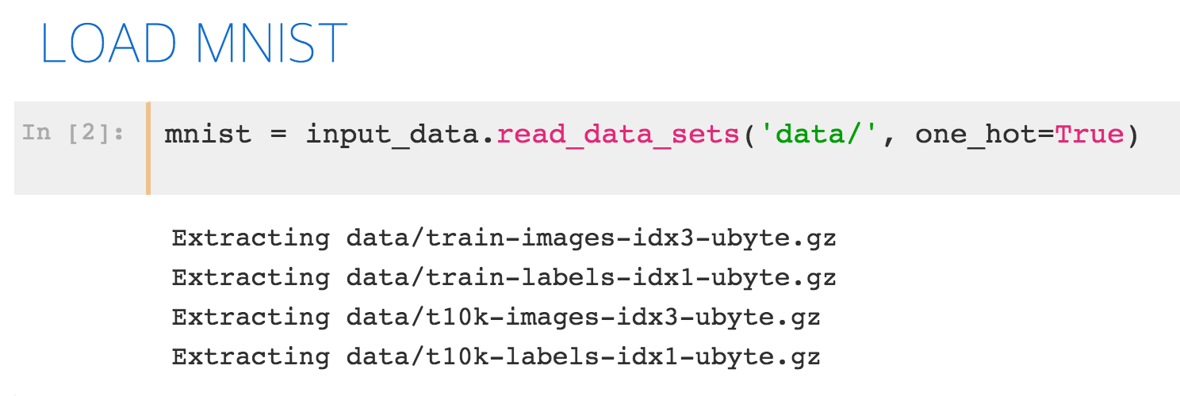
Notes:
import numpy as np
import tensor flow as tf
import matplotlib.pyplot as plt
from tensorflow.examples.tutorials.mnist
import input_data
%matplotlib inline print ("PACKAGES LOADED")

Slide 13
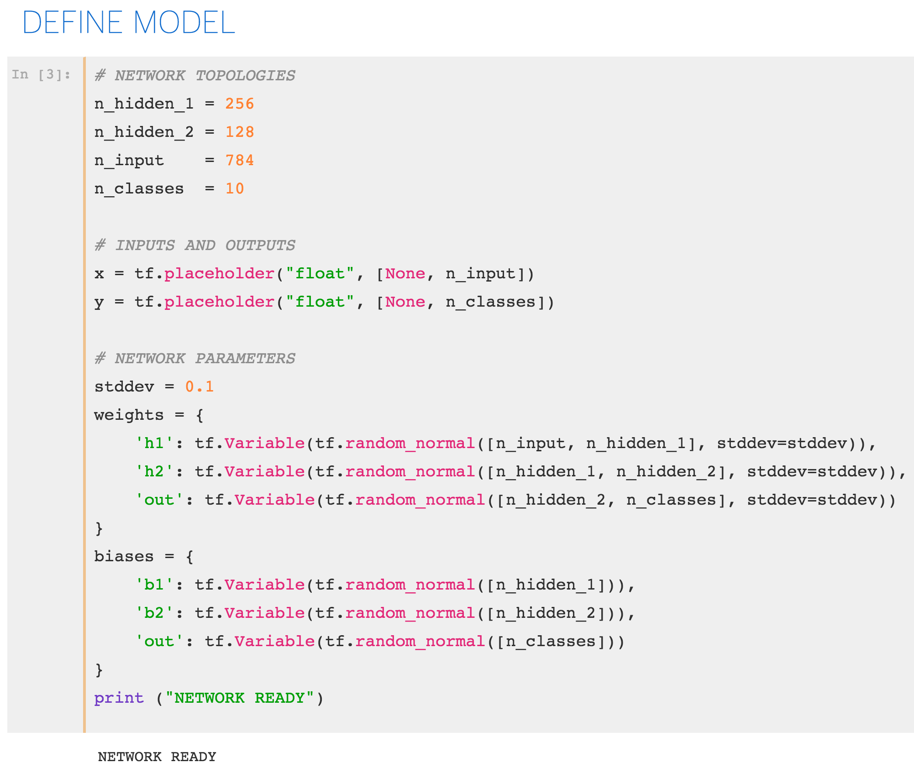
Notes:
import numpy as np
import tensor flow as tf
import matplotlib.pyplot as plt
from tensorflow.examples.tutorials.mnist
import input_data
%matplotlib inline print ("PACKAGES LOADED")

Slide 14
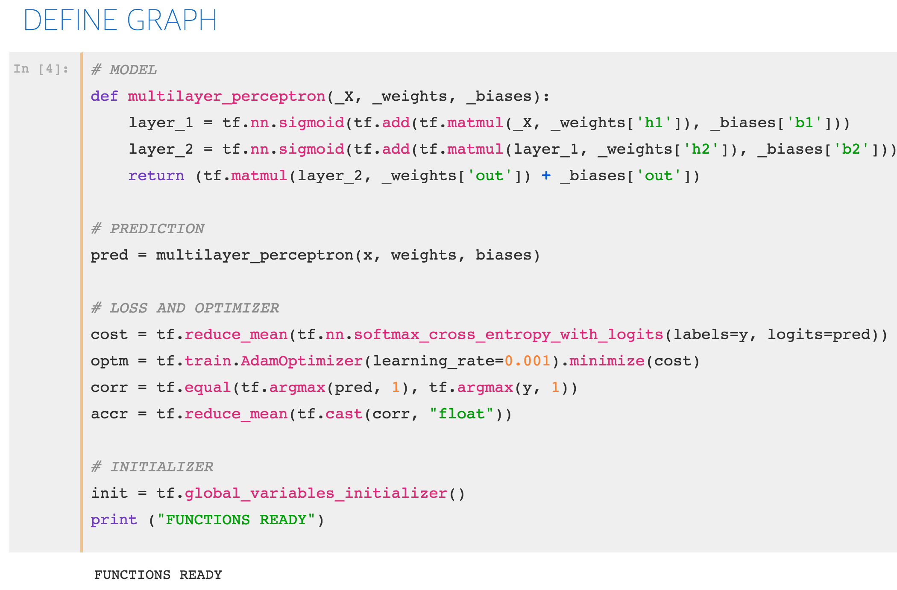

Slide 15
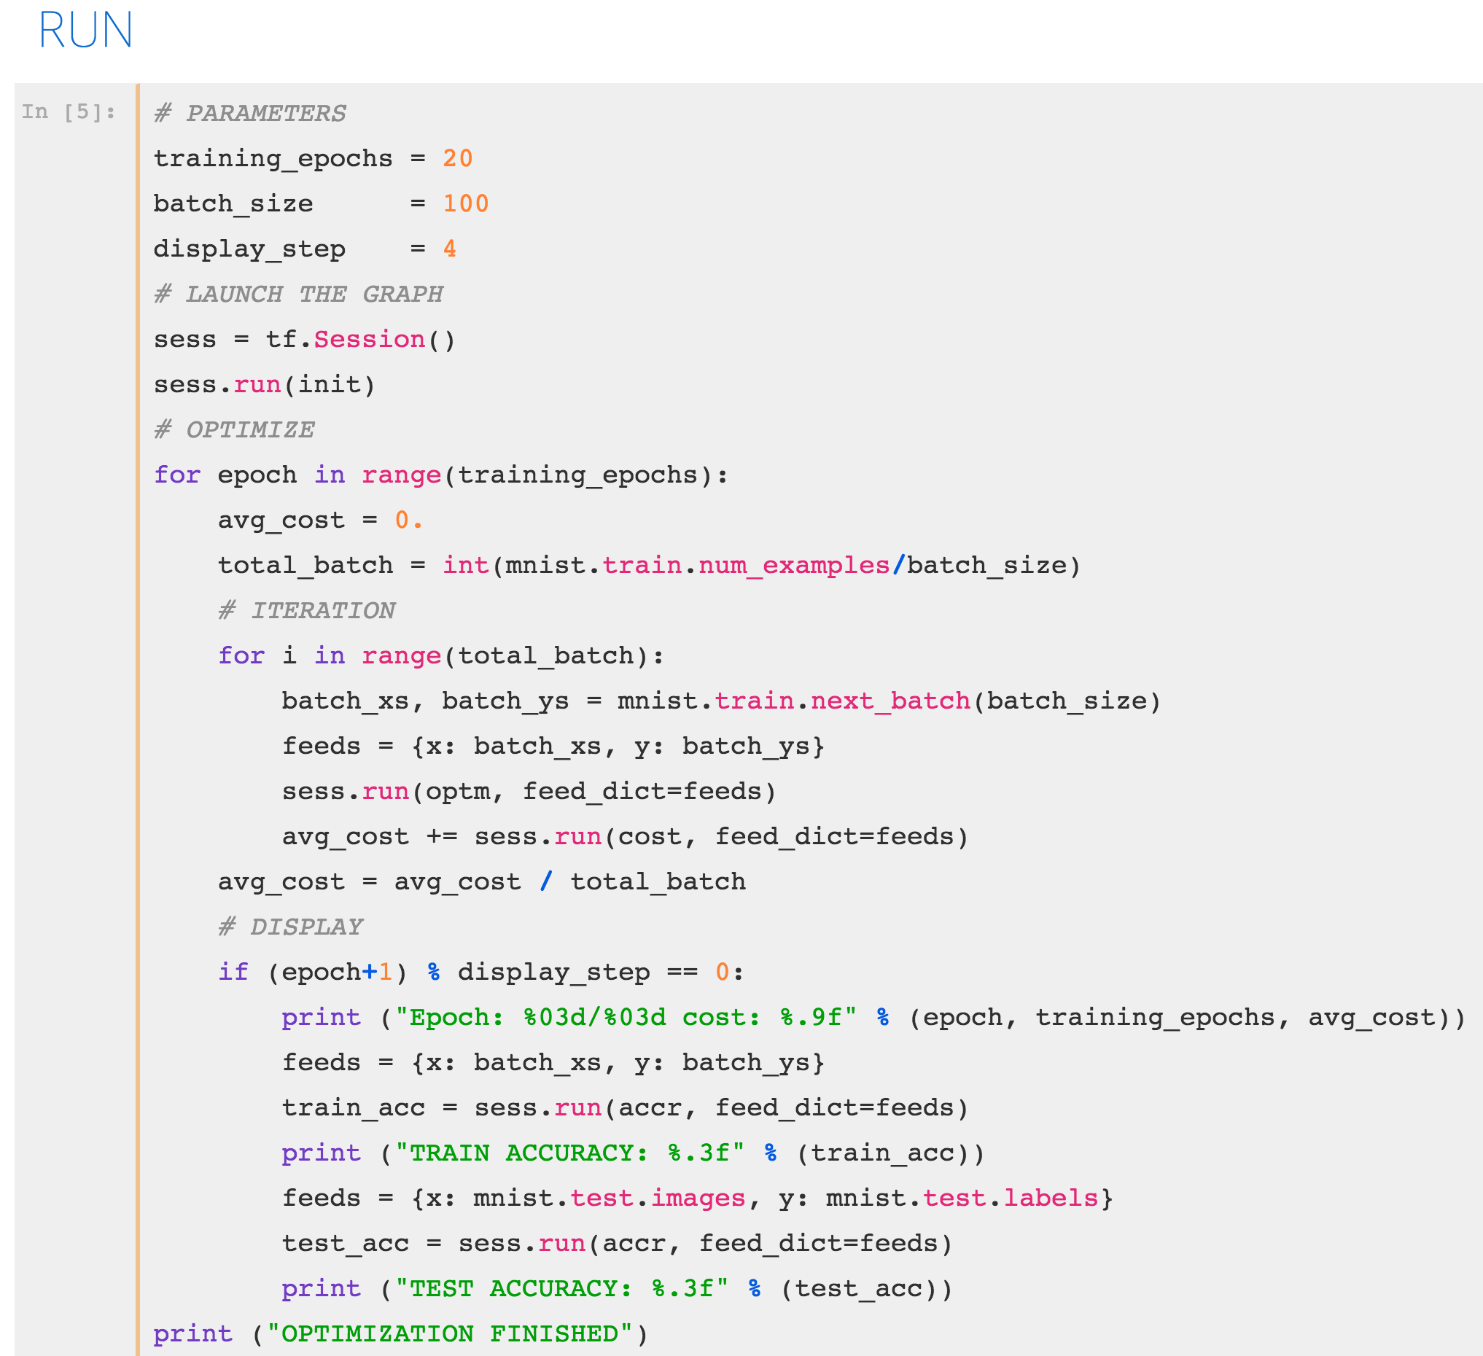

Slide 16
